Slide 1


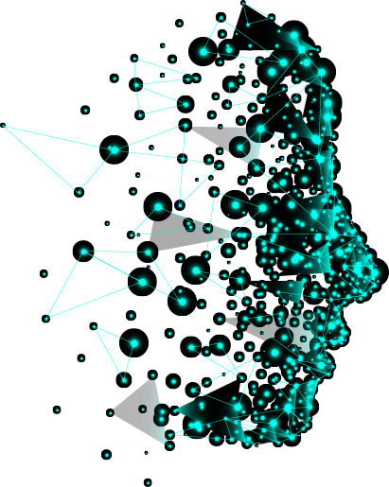







Agentic AI
Agentic AI on IBM Cloud

Slide 2

What is Agentic AI
Agentic AI integrates large language models (LLMs), machine learning, and enterprise automation to create autonomous AI agents capable of decision-making, goal-setting, problem-solving, and adapting to unstructured environments, unlike rule-based AI.

Slide 3





Evolution of Agentic AI
Early AI Models
Focused on predefined rules and automation.
Machine Learning Era
AI began adapting and learning patterns.
Rise of Large Language Models (LLMs)
Enhanced contextual understanding.
Agentic AI Integration
Combining AI, automation, and real-time adaptability.

Slide 4





How Agentic AI Works
Understanding
AI processes data using LLMs and machine learning.
Goal-Setting
Identifies objectives and plans strategies.
Execution
Automates tasks with minimal human input.
Learning
Continuously improves through interactions.

Slide 5



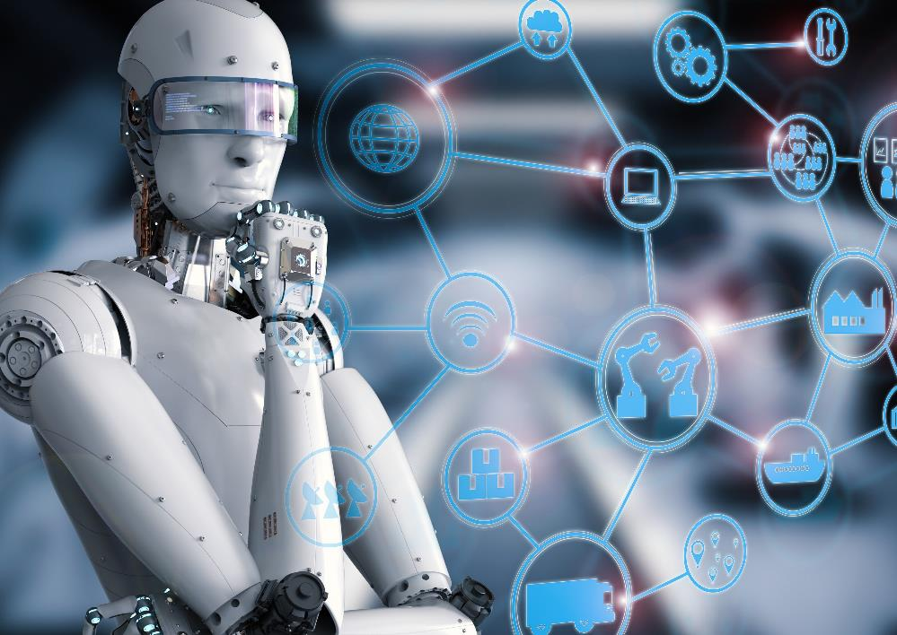



Benefits Of Agentic AI
Efficiency
Reduces manual work and automates complex tasks, improving productivity.
Scalability
AI agents can adapt to business growth and evolving demands.
Adaptability
Responds dynamically to real-time changes and unstructured environments.
Collaboration
Works alongside humans, enhancing decision-making and workflow efficiency.
Cost Reduction
Lowers operational expenses by automating repetitive and resource-intensive processes.
Continuous Learning
Improves performance over time through data-driven insights and machine learning.

Slide 6
Agentic AI Vs. Generative AI
Agentic AI
Generative AI
Autonomous
Creative
Goal-Oriented
Output-Oriented
Real-time Environment
Content-Based
Vs
Utilize Tools and APIs
No external tools
Continuous Adaptation
No adaptation from real-time
Autonomous Systems
Content Creation
Independent Decision-Making
Make decision based on input patterns

Slide 7




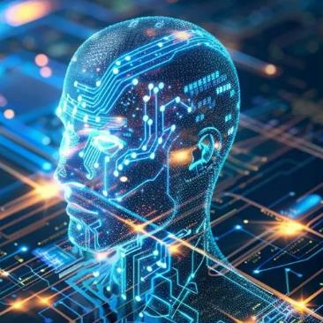
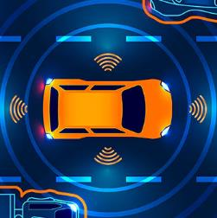



Applications Of Agentic AI
Autonomous Vehicles
Healthcare
Finance
Customer Service
Advanced driver
assistance systems
Electronic health records
Customer relationship management systems
Sentiment analysis chatbot

Slide 8






Use Cases of Agentic AI & Automation
Automated Data Analysis
AI interprets trends in real-time.
Supply Chain Optimization
Predictive analytics improve logistics.
IT & Security
AI-driven cybersecurity threat detection.
Self-Healing Systems
AI resolves technical issues autonomously.

Slide 9

Risks & Challenges of Agentic AI
Risks
Challenges
Bias & Fairness Issues
Ethical Concerns
Security Threats
Regulatory & Compliance Issues
Loss of Human Control
Accountability & Transparency

Slide 10
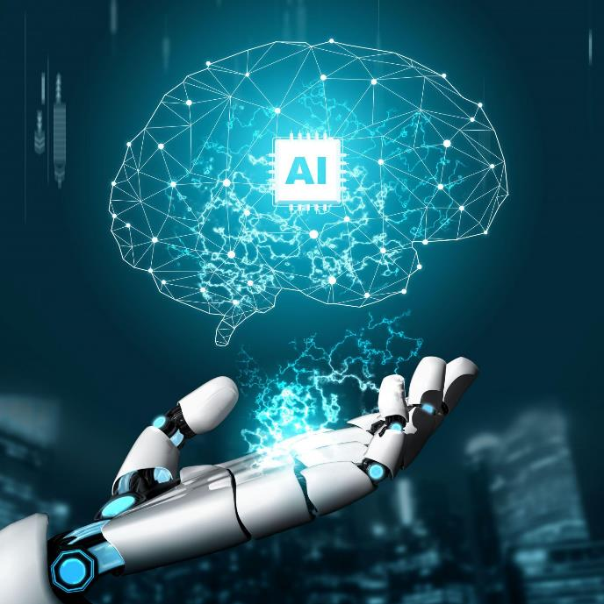
Best Practices For Implementing
Ethical AI Development
Ensure transparency and fairness in decision-making.
01
02
Robust Security Measures
Prevent unauthorized access and cyber threats.
03
Continuous Learning
Enable AI to adapt and improve with new data.
Human Oversight
Maintain control to align AI decisions with business values.
04

Slide 11


Perception
Agentic AI System
Multi-modal fusion
Camera
Text
Audio
Sensors
Cognition
Memory
Decision making
Knowledge Base
User Request
Al Agent
Action
Executing Tasks
Physical actions in real-world
Monitors

Slide 12
Comparison: LLaMA vs Mistral Large
Model | Provider | Size | Modality | Strengths | Agent Support
LLaMA 3 70B Instruct | Meta | 70B | Text | Strong reasoning & instruction-following | Good
LLaMA 3 11B Vision | Meta | 11B | Text + Vision | Multimodal capabilities | Moderate
LLaMA 3.3 70B FP8 | Meta | 70B (FP8) | Text | Optimized for inference | Good
Mistral Large | Mistral AI | 40B+ (est.) | Text | Advanced reasoning, native JSON | Strong

Slide 13

Conclusion & Key Takeaways
Agentic AI is revolutionizing automation beyond simple processes. Businesses must adapt as AI shapes the future of work. Ethical AI development is essential for responsible use, and AI will continue evolving, driving innovation and transformation.

